Slide 1
Introduction to Discrete Event Simulation Session 13
Arnold Buss
MOVES Institute
Naval Postgraduate School
Monterey, CA 93943

Slide 2
Overview
Steady-State analysis
Issues with data in steady-state
Reaching steady-state
Data in steady-state still correlated
Truncation (“Warmup”)
Replication/Deletion

Slide 3
Issues with Steady-State
Initial conditions not typical of steady-state
Steady-state measure may be very different from initial observations
Initial observations typically biased with respect to steady-state measure
In steady-state, observations are still auto-correlated

Slide 4
Illustration of Initialization Bias

Slide 5
Truncation
Since initial observations are biased, “warm-up” simulation by running for awhile then clearing statistics and carrying on
For tally data:
For time-varying data:
Where T is the truncation point

Slide 6
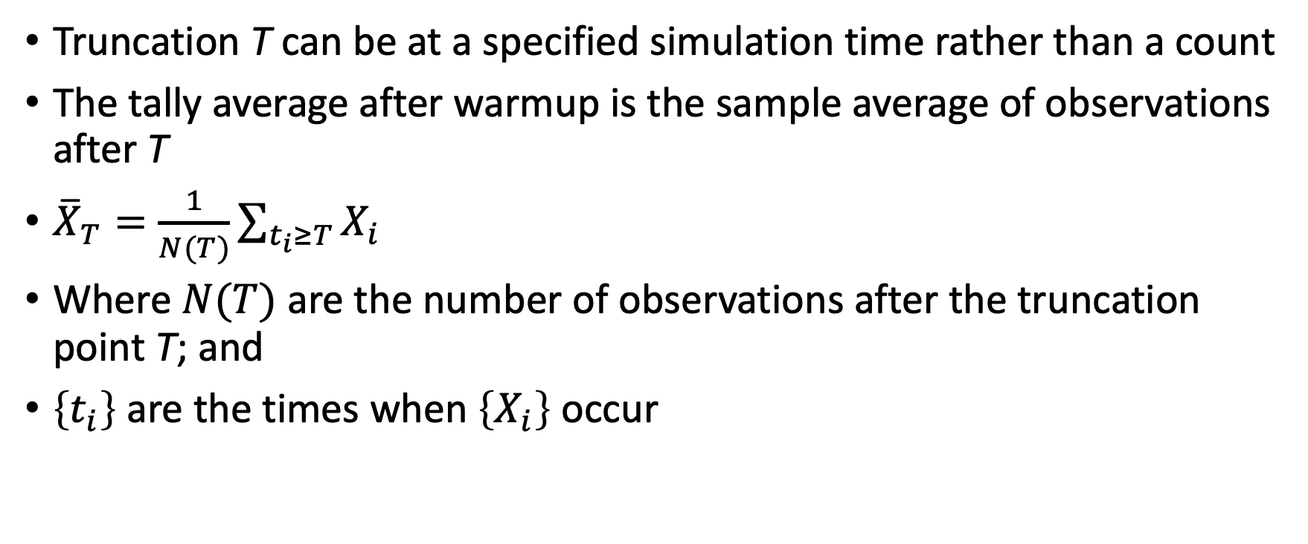
Alternative for Tally
Truncation T can be at a specified simulation time rather than a count
The tally average after warmup is the sample average of observations after T
${\overline{X}}_{T}=\frac{1}{N(T)}\sum_{t_{i}≥T}{X_{i}}$
Where $N(T)$ are the number of observations after the truncation point T; and
$\left\{t_{i}\right\}$ are the times when $\left\{X_{i}\right\}$ occur

Slide 7
Steady-State Measure (Mean)
Unlike terminating case, steady-state measure is a single value
If in steady-state
Data are identically distributed (are at least have the same mean)
However, the data are still correlated
The usual estimate of the variance is biased
To form a confidence interval, still need to get to “iid”

Slide 8
Replication/Deletion Method
One replication consists of truncating data at the warmup (“deletion”)
Then continuing to sample in ”steady state”
Aggregate measure in steady state (e.g. mean) is one observation
Repeat independently and form confidence interval

